Slide 1
Come with us on our Journey
Kate Sullivan Orientation
2020-2021

Slide 2
Mr. Bryan Principal
Principal's Message
2020-2021

Slide 3
Who is attending Digital Academy?
In a word: EVERYONE.
In the event that any of our Crocodiles need to be learning from home we want to ensure that they are comfortable and confident using the Canvas Learning Management System. Additionally, this will provide us the opportunity to begin exploring Blending Learning as an instructional approach.
Notes:
Slide 3. Everyone is attending Digital Academy. Meaning, What is being taught at home is what is being taught in the Brick and Mortar classroom. This is so that in the event we have to move to Distant Learning, the transition will be seamless.

Slide 4
What is Blended Learning?
In a nutshell, Blended Learning is a research-based instructional approach where students learn partially online, partially in a brick and mortar location, and along a more individualized path designed to provide a more integrated learning experience. NOW, given the many challenges presented to us this year, we will not be able to fully operationalize a Blended Learning model but this well-established instructional approach does provide us with a wealth of information that will assist our teachers as they plan and prepare for instruction.
Notes:
Slide 4. Teachers are teaching both on-line and brick and mortar. However, second grade has two dedicated teachers teaching digitally, the rest are solely teaching brick and mortar.

Slide 5
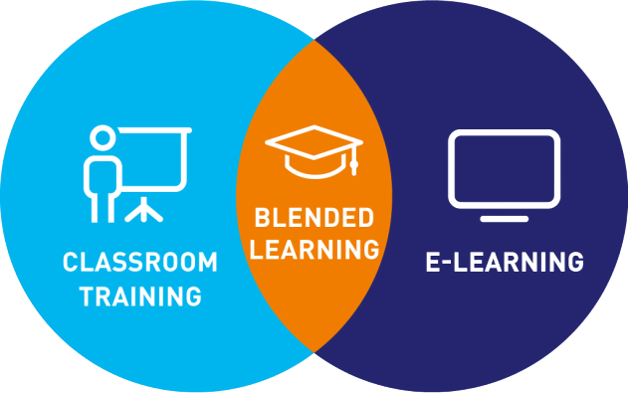
Blended Learning Cont…
If, ultimately, Blended Learning is a chance to reinvent what learning looks like for our students, then we see this next year as an opportunity to develop some ways-of-work that will sustain us in the future. The 1:1 commitment made by our district ensures that our students will have blended learning experiences for years to come. We all know what they say about life, lemons, and lemonade….we are going to approach the 2020-2021 school year as chance to make some lemonade!!

Slide 6
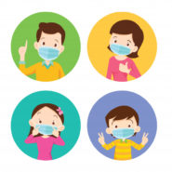
Safety First!
Kate Sullivan Elementary School 2020 Protocols and Procedures

Slide 7
Prevention
01
02
03
MASKS
SPACE
HANDS
Masks must be worn anytime you are inside or around others, especially within six feet.
Students and staff must remain six feet apart to every extent possible.
Hand washing and sanitizing must occur frequently.

Slide 8
How will our Children be Learning?
LIVE CHAT
INSTRUCTION
SERVICES
Communicate live with teachers and students.
Students will have moments of live instruction, independent work, small group instruction, and BREAKS.
Any students who receive services will continue to receive those services LIVE.

Slide 9
How will our Children be Learning?
Students will use our new learning management system, Canvas, to access everything!
Accessible to all students through their ClassLink accounts.
Link with learning modules, assignments, and more.
Turn in completed work and receive feedback from teachers.
Live instruction, independent work, small group instruction, and BREAKS.
Any students who receive services will continue to receive those services LIVE.
Notes:
Slide 9. Students have access to the new curriculum through CLassLink. Canvas is the new learning management system of learning. This is where students will access their lessons, assignments, submit work, receive feedback on assignments, etc. Note the last bullet.

Slide 10
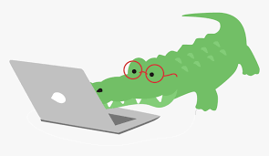
Learning from Home this Year?
Here are a few student and parent tips…

Slide 11
What will our Children Learn?
Our students will still be receiving Florida Standards aligned instruction in all core academic areas: English Language Arts, Math, Science, and Social Studies. They will also receive P.E., Art, and Music.
We will continue to use vetted curriculum resources such as, but not limited to, Canvas Digital Modules, Wonders, Go Math!, Fusion’s Science, etc.
Notes:
Slide 11. Students will receive the 4 core academic subjects (I.e. Language Arts, Math, Science, and Social Studies) that are aligned with the Florida Standards.

Slide 12
At Home Student Expectations
All students are expected to go LIVE at 8:30 a.m. for their Morning Meeting. Daily attendance will be taken at this time. Students who are not present during this meeting will be marked absent or tardy. If you are late, please contact your teacher as soon as you are present. If you have an appointment, please provide the appropriate documentation so that the tardy/absence can be excused
Students are expected to access daily schedules, assignments, due dates, etc. through Canvas
Students are expected to complete all assignments in a timely manner; assignments are graded work not just evidence of participation
Students (and/or parents) are expected to contact their teacher with all questions and concerns about assignments
Notes:
Slide 12. Home expectations: students are to adhere to the class schedule. Digital Teachers will expound further if needed.

Slide 13
Parent Expectations
Parents are expected to sign up for Parent Portal in FOCUS in order to keep up with student grades
Parents are expected to sign up for Parent Canvas in order to keep up with assignments and other posted information; this information should be kept up with in the same manner as the agenda book and other school-to-home communications
Parents are expected to help students stick to their daily schedules
Parents are expected to make sure students are completing work as assigned
Parents are expected to assist their child in creating an at-home learning space designed for maximum success; parents are expected to offer encouragement, and parents are expected help students remain on-task and on schedule

Slide 14
Parents are expected to help students learn ON THEIR OWN….a moment of guidance, words of encouragement, a quick clarification or restatement is absolutely okay…teachers do this all the time…however, we need our students to show us what they are capable of doing independently, in order to provide them with the most appropriate instruction.
Notes:
Slide 14. It is important to encourage students to become independent learners. It not only builds self confidence, it helps to build life skills.

Slide 15
Morning Arrival Procedures
All 2nd graders will enter through the Front Doors of the school.
Stand at marked 6ft intervals on brick sidewalks in front of the school and leading into the building.
Staff will conduct the Daily Health Screening upon entrance
Students will report directly to their homeroom teacher’s classroom
Any student who does not pass the Daily Health Screening will be sent tour Quarantine Room, where they may be assessed a second time, and either wait for a parent to pick them up or be sent back to class if the second screening was acceptable.
Bus Riders: Staff will conduct the Daily Health Screening as students get on and off the bus. These students will report straight to their homeroom teacher’s classroom.
Notes:
Slide 15. Any questions?

Slide 16
Once in the Classroom
7:45-8:25
Students must finish eating their breakfast
Those not eating breakfast may read or view an educational video
At 8:20, teachers collect breakfast trash in garbage bags provided.
8:30-8:45
Attendance and Morning Meeting (LIVE)
Pledge of Allegiance
8:45
Class Instruction Begins

Slide 17
Daily Schedule
(Tentative)
8:30-8:45 Attendance and Morning Meeting
8:45-9:10 ELA Instruction LIVE/Prerecorded
(Work in Breathing Break)
9:10-10:40 Independent ELA Block / Small groups / Interventions
10:40-10:50 Mask Break
10:50-11:20 Social Studies / Science - LIVE/Prerecorded
11:25-12:10 Special Area (Push in)
12:10-12:30 Social Studies / Science (cont.) /Independent
12:30-1:10 LUNCH (allow for adjustable lunch times)
1:10-1:40 Math Instruction LIVE/Prerecorded
(Work in Breathing Break)
1:40-2:30 Independent Math Block /Small Groups
2:30-2:40 Mask Break
240-2:50 Transition to Dismissal

Slide 18
Special Areas (A detailed schedule will be provided)
Art, Music, & Media
P.E. & Developmental Play
These will occur in the individual classrooms.
(S.A. Teachers Pushes in)
Will occur outside as weather permits.

Slide 19
Lunch Procedures
(Tentative)
Grab and Go
Adjusted seating
On & Off Cafeteria schedule

Slide 20
MASK BREAKS!
There is no dedicated recess time attached to lunch.
We will build two 10-15 mask breaks into the daily schedule that will occur outside (distanced).
Possibility of “Outside Bins” with hands on things like chalk, jump rope, etc.

Slide 21
Car Pick-up
Students will move to the Car Pick-up loop at 2:45. They will line up on the 3-5 playground in their designated area with social distancing protocols in place.
ALL students must be required to wear a mask
All students must remain in the Car Pick-up Loop until parents arrive
The parents that “walk” to campus will be directed to a staff member at the double gate on the 3-5 playground
Car Pick-up Tags will be REQUIRED for all parents.
Notes:
Slide 21. Any questions?

Slide 22
Afterschool Dismissal Procedures
Bus Loop, Car Pick-up Loop, and the 3-5 Playground.
There will be NO “Room Waiters”
All students wear masks for dismissal
If you drive, go through the Car Pick-up loop instead of parking and walking.
Parents who truly walk to campus to pick up their student will be identified in advance by the teacher and these parents will report to the double gate at the 3-5 playground.
Parents will not be permitted to walk up to the Parent Pick-up Loop to connect with their student.
Bus Pick-up: One teacher escorts to Bus Loop/Masks/Support staff will receive students
Notes:
Slide22. Any questions?

Slide 23
KSE Afterschool Program
Line Up
Staff
Line up in designated spots on 3-5 playground.
Afterschool staff will be there to receive them, then escort them to the cafeteria.

Slide 24
East Hill & Lafayette Park
Line Up
Staff
Line up on designated spots on K-2 playground.
Program staff members will pick them up form there and lead them off campus.

Slide 25
Absences
If your child is absent, the State of Florida requires you to send in a note stating the reason for your child’s absence. Please send in the note the day your child returns to school. It is important that your child only miss school if he/she is ill. We will work with you to make up any graded work that is missed.
Notes:
Slide 25. Any questions?

Slide 26
Tardies/Early Departures
If your child is late for school, your child must walk in to sign into the front office. Your child will be marked tardy if they enter the classroom after the late bell at 8:35.
If your child has to leave school early for any reason, if possible, please send a message on Remind that morning, so that we can have your child ready and packed up in time.
If the nurse is sending your child home sick, you do not need to send in a note.
Tardies and early departures are recorded on your child’s permanent record.
Notes:
Slide 26. Any questions?

Slide 27
Classroom News
For announcements and updates please continue to check your teacher’s website, as well as the school’s homepage.
Utilize Focus, Remind, and Canvas

Slide 28
Birthday Celebrations
We will still be able to celebrate birthdays
Parents/Guests will not be allowed in the building
You may send your child with individual baggies for the teacher to distribute to the class
Please be cautious with food items (Ask your teacher for an allergy list)
Notes:
Slide 28, Any questions?

Slide 29
At this time, Leon County Schools has decided that we will not be able to have volunteers or mentors in our school. This may change for the second semester.

Slide 30
Supply List
(2) 24 Packs of Crayola crayons
12 Pack Sharpened Ticonderoga Pencils
1 Pair Kids Scissors
2 Composition Books
2 Small Glue Sticks
1 Green pronged duo tang (science folder)
1 Blue pronged duo tang (social studies folder)
2 Dry Erase Markers
Crayon Box
Durable headphones/ear buds
Mask
Labeled Reusable Water Bottle
1 Pack Wide-Ruled Notebook Paper
Optional:
10-pack washable markers
Small enclosed personal pencil sharpener
Mini-sized individual use hand sanitizer (Classroom sanitizer will also be available)
Mini-sized packet of tissues
*See teacher for additional items needed

Slide 31
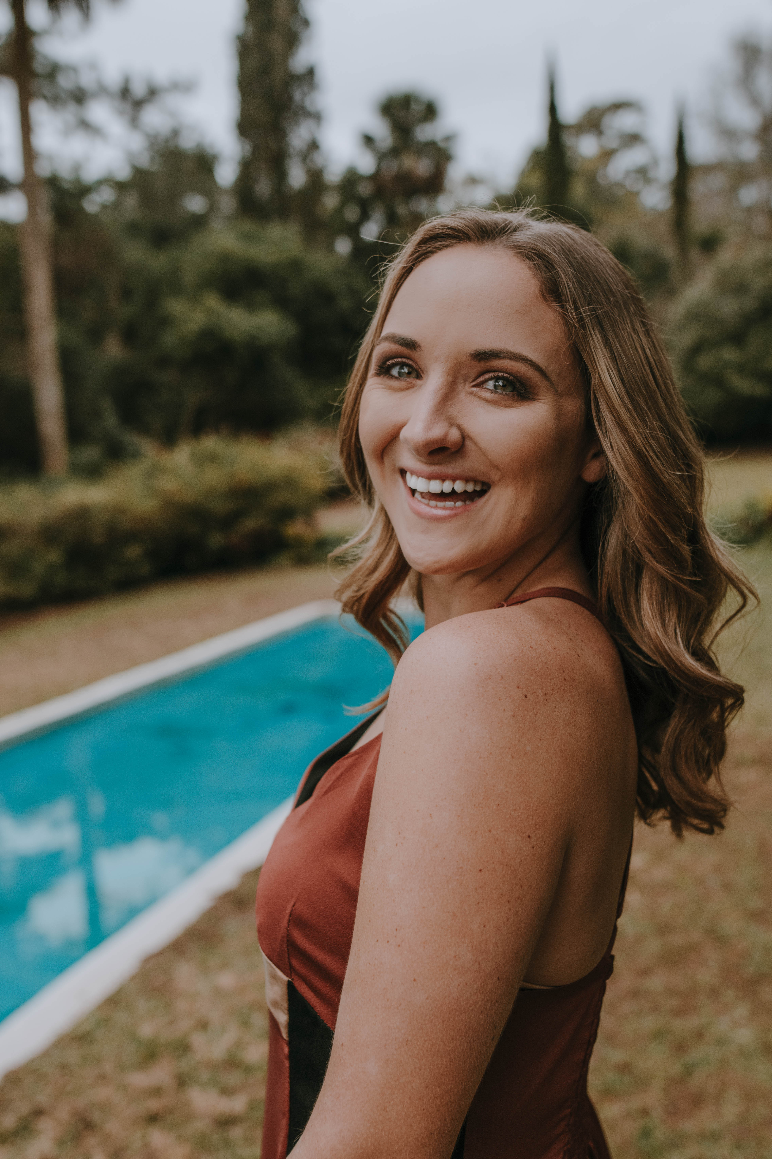
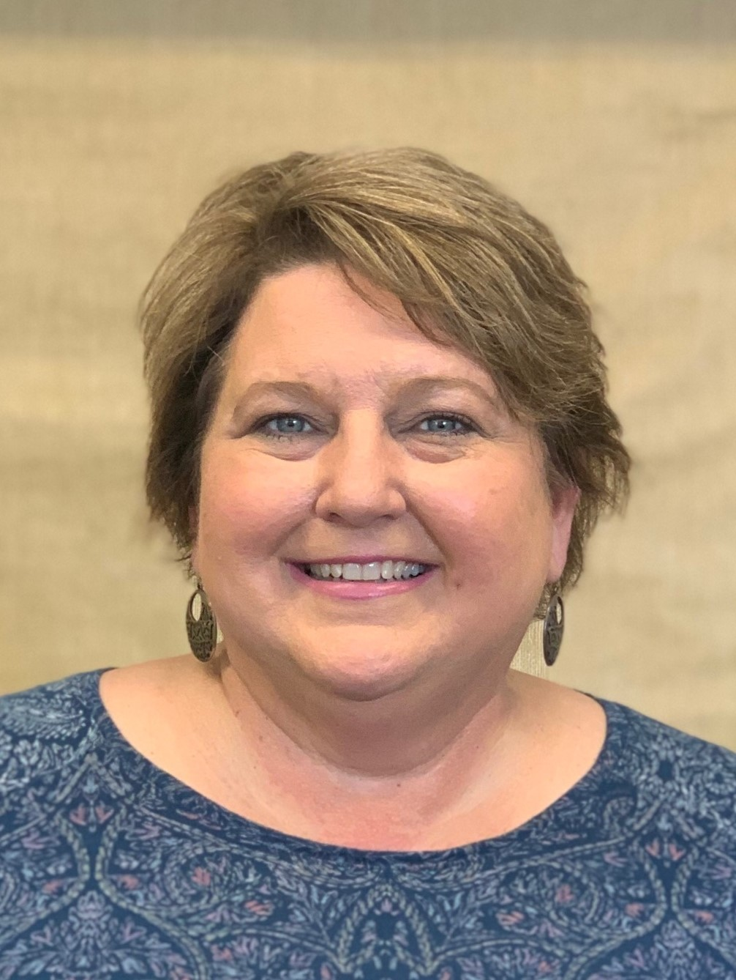
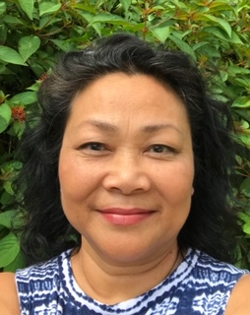
OUR TEAM
Brick and Mortar Teachers
(Face to Face)
Lisa Merchant
Debbie Nesmith (Team Leader)
Julia Bowden​
TBA

Slide 32
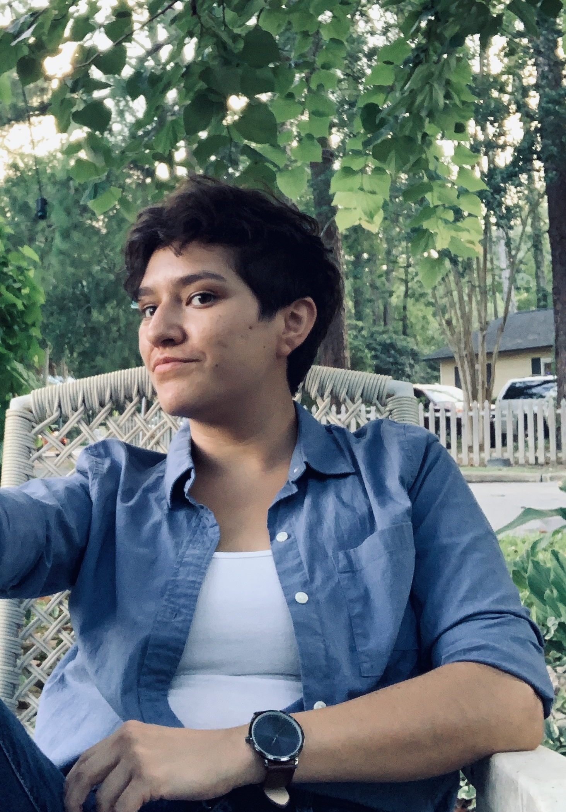
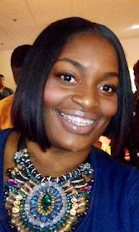
2nd Grade
Digital Teachers
Samantha Bouie
Mary Twyman

Slide 33
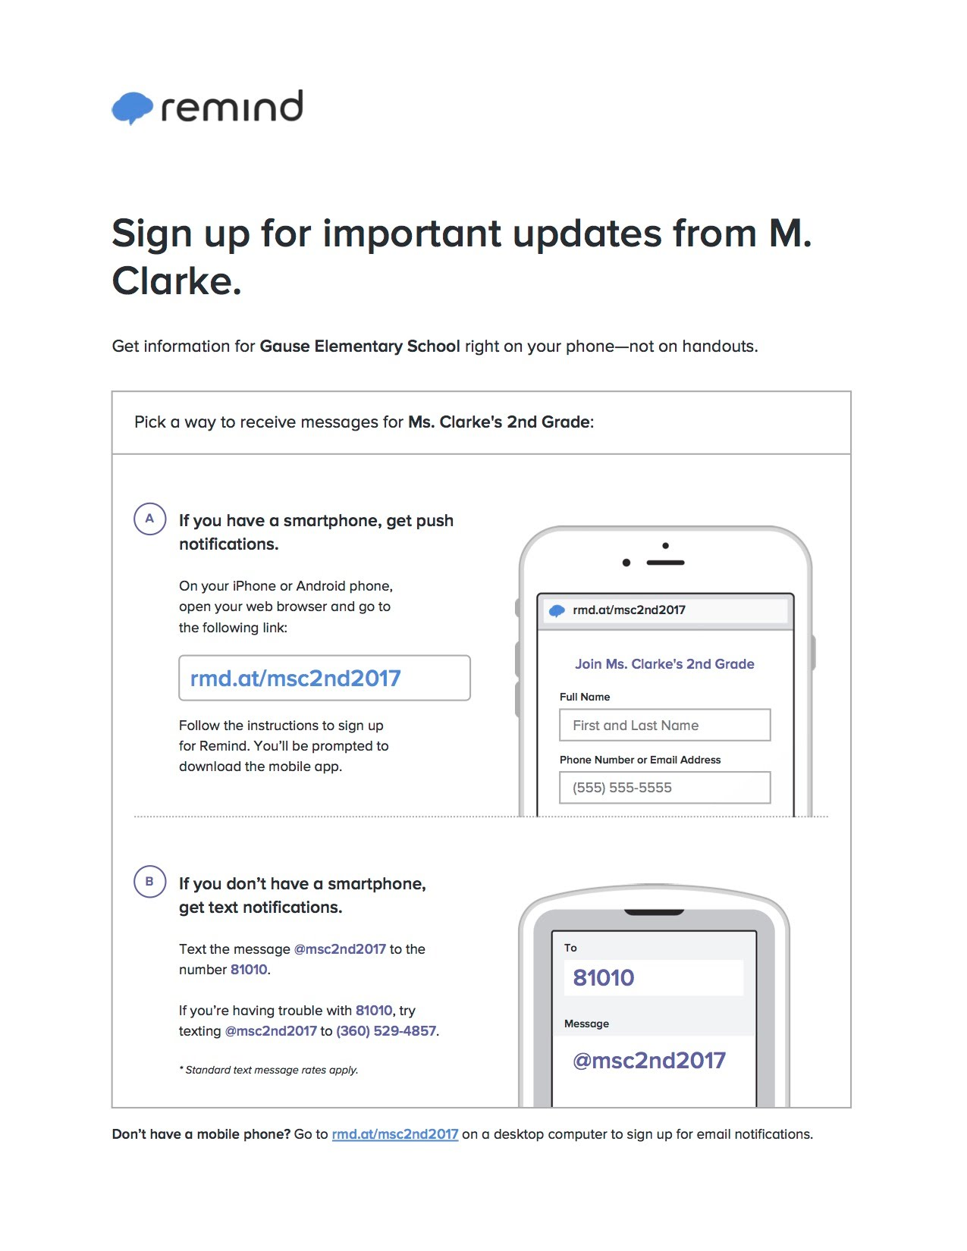
Join Remind!
Ms. Bowden
remind.com/join/bowden020
Ms. Bouie
remind.com/join/msbouies2
Ms. Merchant
Remind.com/join/lmerchant2
Mrs. Nesmith
remind.com/join/nesmith020
Ms. Twyman
remind.com/join/twyman2020
Get daily updates and reminders.
Visit the link from your child’s homeroom teacher to join!

Slide 34
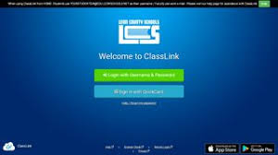
ClassLink Leon
Go to leonschools.net, Click the ClassLink Tile
Login with
Student ID @edu.leonschools.net
Password: Lunch Pin

Slide 35
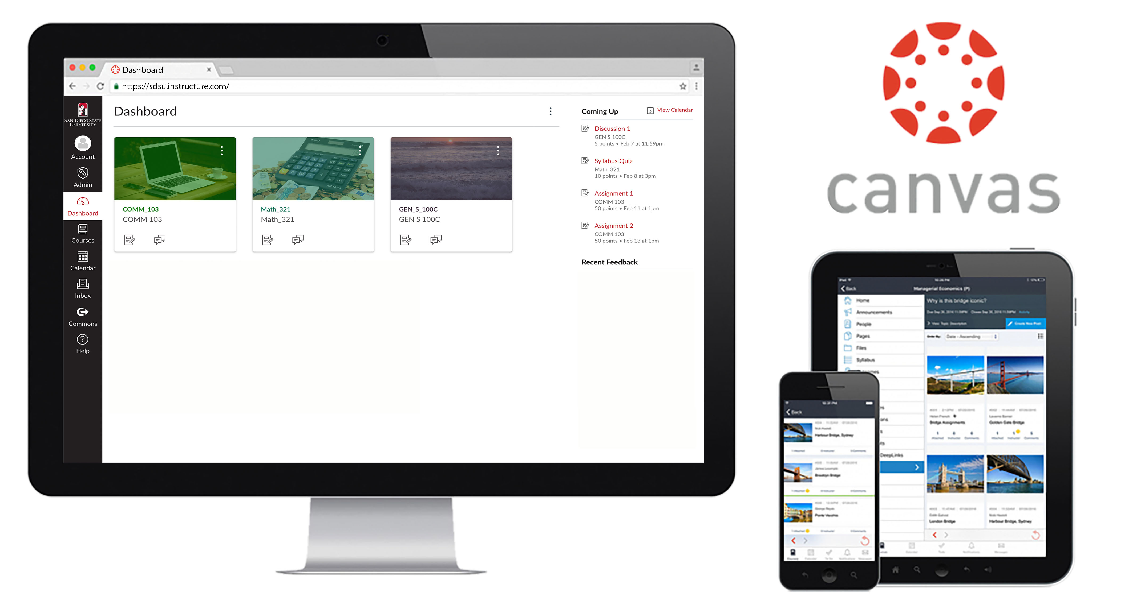
TABLETS
Accessible on Tablet!

Slide 36
“All things are difficult before they are easy.” -Thomas Fuller

Slide 37
THANKS!
Do you have any questions?
Email your child’s teacher so it can be answered during the LIVE Q & A!
CREDITS: This presentation template was created by Slidesgo, including icons by Flaticon, and infographics & images by Freepik.
Please keep this slide for attribution.

